Slide 1
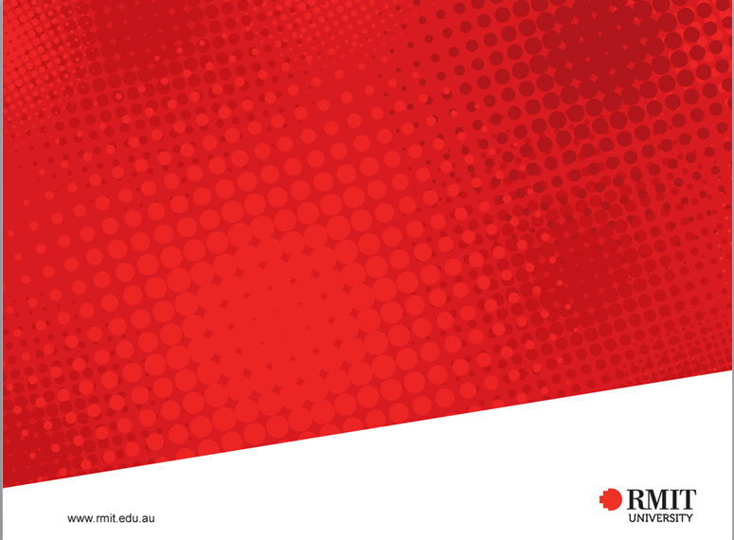
EEET2449 Research Methods for Engineers
Lecture 3: Preparing your ‘Literature Review’ assignment
Dr Francisco Tovar
Francisco.tovarlopez@rmit.edu.au

Slide 2
Some common mistakes ….
1. Do not start a sentence with a reference:
[7], [5], [8], [2] state that non-linear models are more flexible in reflecting …..
In [2], they attempted to recreate a 2-D spatial multizone ……
2. Do not cite the name of the authors:
According to Lu, X. Wang, Z. Suo and J. Vlassak, inorganic film coating on a polymer substrate is preferred …..
A study by Kurs, Karalis, Moffatt and Joannopoulos [3] found that a wireless power system …..

Slide 3
3. Do not cite the title of the paper:
the paper “Self-evaluated automatic classifier as decision-support tool for sleep/wake staging” (6)
4. Do not copy/paste sentences from the papers:
demonstrated two limitations as a result of hand-held electrodes employed in the study; “the possible resolution and large threshold currents...which was ten times greater than animal study thresholds” [8, p. 64].

Slide 4
5. Make sure that the first paragraph is supported by at least one reference:
Audio engineering is a field of engineering that focuses on the manipulation, mixing, recording and reproduction of sound. The two branches of audio engineering include producing sounds for digital media such as films, video games and music while the other branch specialises in designing new technologies for sound reproduction [no reference].

Slide 5
6. Do not describe references in separate paragraphs:
Following on, cited the 2012 paper [5], in order to optimize energy and ancillary services (load regulation and spinning reserves) scheduling, a new V2G algorithm is formulated. The algorithm is developed to be used by an aggregator, which maybe a utility or a third party. This algorithm maximizes profits to the aggregator while providing additional system flexibility and peak load shaving to the utility and low costs of EV charging to the customer.

Slide 6
7. Put references in the order of their appearance:
Over the last two decades, the computer hardware industry has been relying on (Complementary metal– oxide–semiconductor) CMOS integrated circuit technology to manufacture computer microchip and Printed Circuit Board (PCB) [1]. Although this technology has been facing physical limitations, recent development has resulted in increase in speed and their reduction in sizes as predicted by Moore in 1965. Nanocomputer architecture shows a promise to provide solutions to the inherent shortcomings of the past technology. The design can be analysed by the power consumption, size, and the speed. The basic idea of nanoscale technology is to achieve higher performance by using lower energy and less area of the devices. The work done towards nanocomputer technology and the architecture frontiers is accessed here as well as identify the best nanocircutry architecture can be applied in future [8].

Slide 7
8. Avoid paragraphs longer than 6-8 lines, as it is hard to follow them

Slide 8
Some good papers to follow the flow of their literature review …
Example 1:
Reduced Cost Photonic Instantaneous Frequency Measurement System
IEEE Photonics Technology Letters, 2008, 20, 1521-1523
Example 2:
Design optimization and optimal control for hybrid Vehicles
Optimization and Engineering, 2011, 12, 199-213
Example 3:
A hydrodynamic microchip for formation of continuous cell chains
Applied Physics Letters, 2014, 104, 203701

